Slide 1
StarWind 5.0
High Availability Storage
& Open iSCSI SAN
Turn Any Windows Server into a Fault-Tolerant SAN.
Enterprise Features. SMB Price.TM

Slide 2
StarWind 5.0 webinar for partners and VARs.
In this webinar:
  StarWind Software Overview;
  Key Benefits;
  IT Projects and use cases;
  What’s new in StarWind 5.0;
  LIVE demonstration of true Active-Active High Availability, automatic failover and failback in StarWind 5.0;
  Enterprise class features overview;
  New editions comparison chart;
  SKUs and MRPs;
  Upgrade prices and procedures;
  Contact Information;
  Presenters: Dmitry Filimonov, Senior Storage Solutions Engineer;
  Roman Shovkun, EMEA-APAC Sales Department Director

Slide 3
Overview
Leader in Storage Virtualization and iSCSI storage since 2003
Pioneer and early technology adopter in the iSCSI storage since 2003
Over 30,000+ global users in over 100 countries
Designed to work as shared storage with server clusters
Works with virtualization technologies including VMware, Hyper-V, XenServer
StarWind Advantage
Rock-solid reliability
Fast Performance
Easy to Manage and Administer
Windows Server 2008 R2 Failover Clustering and 64-bit support
Enterprise-Class Features: CDP/Snapshots, Mirroring/Replication and Thin Provisioning
Most Affordable, High Availability Storage for SMBs

Slide 4
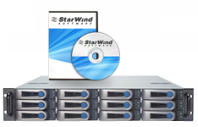
Benefits of Open SAN Software
Interoperability with universal, standard and non-proprietary technologies
  Works over existing Ethernet network - IP is a universal and non-proprietary technology used globally for the past 30 years
  Allows IT professional to have the freedom to use existing and standard equipment
  Works on any x86 server with 64-bit or 32-bit Windows
  Converts any Windows server into centralized, networked storage for any application
Reliable, highly available, fast, affordable

Slide 5
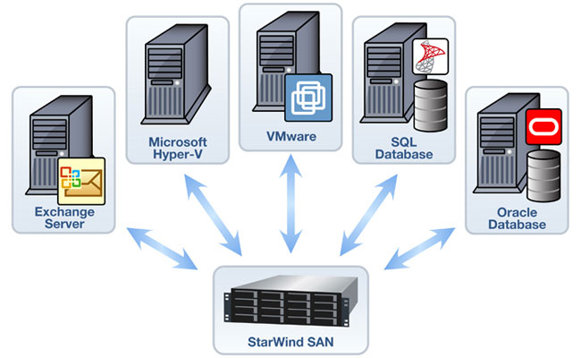
Shared Storage
Shared Storage that is ideal for any server application

Slide 6
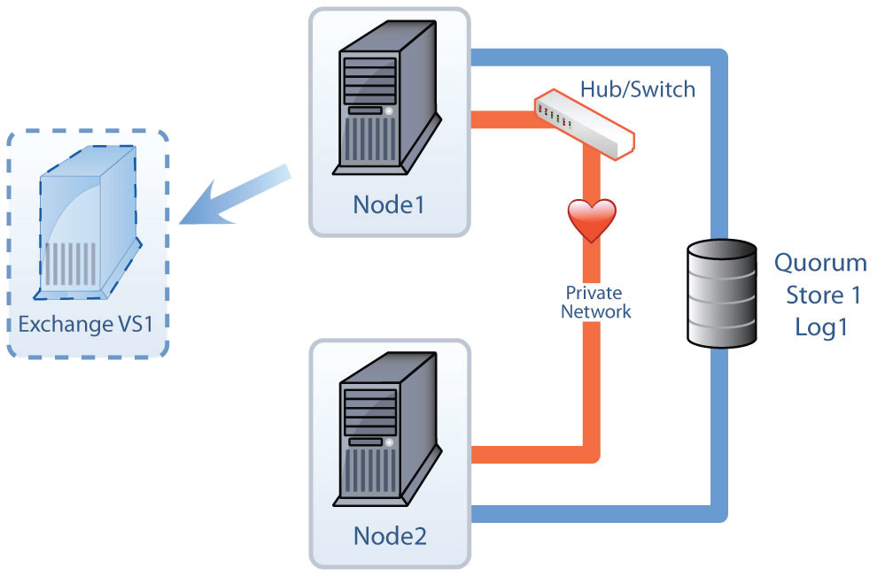
IT Projects
Server Clustering and High Availability
Hyper-V or VMware
Storage Consolidation
Server Consolidation
Disaster Recovery
Shared Storage

Slide 7
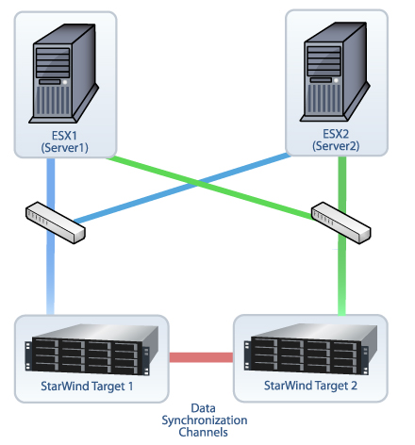
High Availability: Automated Failover and Failback
Synchronous Mirroring with
Active-Active Automated Failover
Failback with Fast Synchronization
Continuous data availability without a single point of failure.

Slide 8
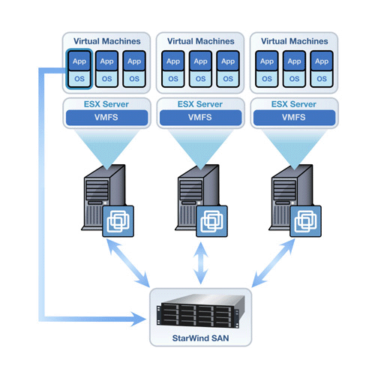
Enables VMware’s Advanced Features
Enable the use of VMware HA, VMotion, Storage VMotion,
DRS.
Increase application and data availability
Protect against a single point of failure

Slide 9
Enterprise Features
Synchronous Data Mirroring with Active-Active Automated Failover and Failback
Replicate mission-critical data using Synchronous Mirroring to another server in your server room.
Remote Replication over the WAN
Asynchronous Replication across a campus or even a WAN enables volume/site failover and recovery for uninterrupted storage operations and 24/7 business continuity.
Instant Point-in-Time Snapshots
Live snapshots for recovering either individual files or folders or even entire volumes hence allowing you to rollback the volume to a point prior to failure.
Thin Provisioning
Offers efficient disk utilization so that IT administrators do not have to purchase disks ahead of time. Thin Provisioning allocates only as much space as is required for data on that volume.
Other Features
NTFS compression and encryption integration, shared volumes for clustering servers, support for VSS, RAM disk, 64-bit and 32-bit architecture, support for MPIO, software RAID-1 mirror, Virtual Tape Library (VTL).

Slide 10
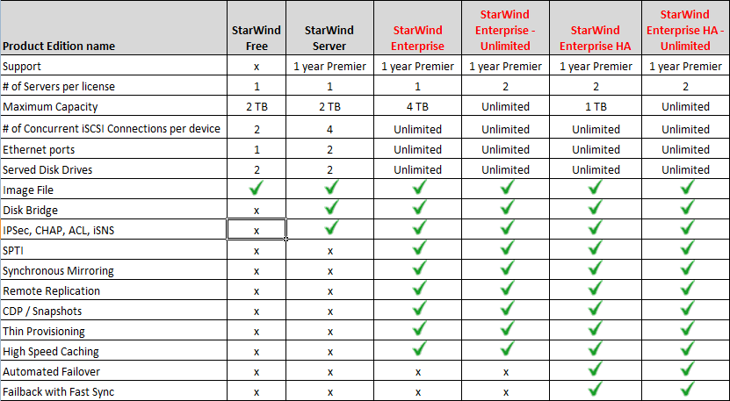
StarWind Editions Comparison Chart

